Slide 1


Optical Character Recognition Using OCR Tessuract Engine
By Abhishek C

Slide 2
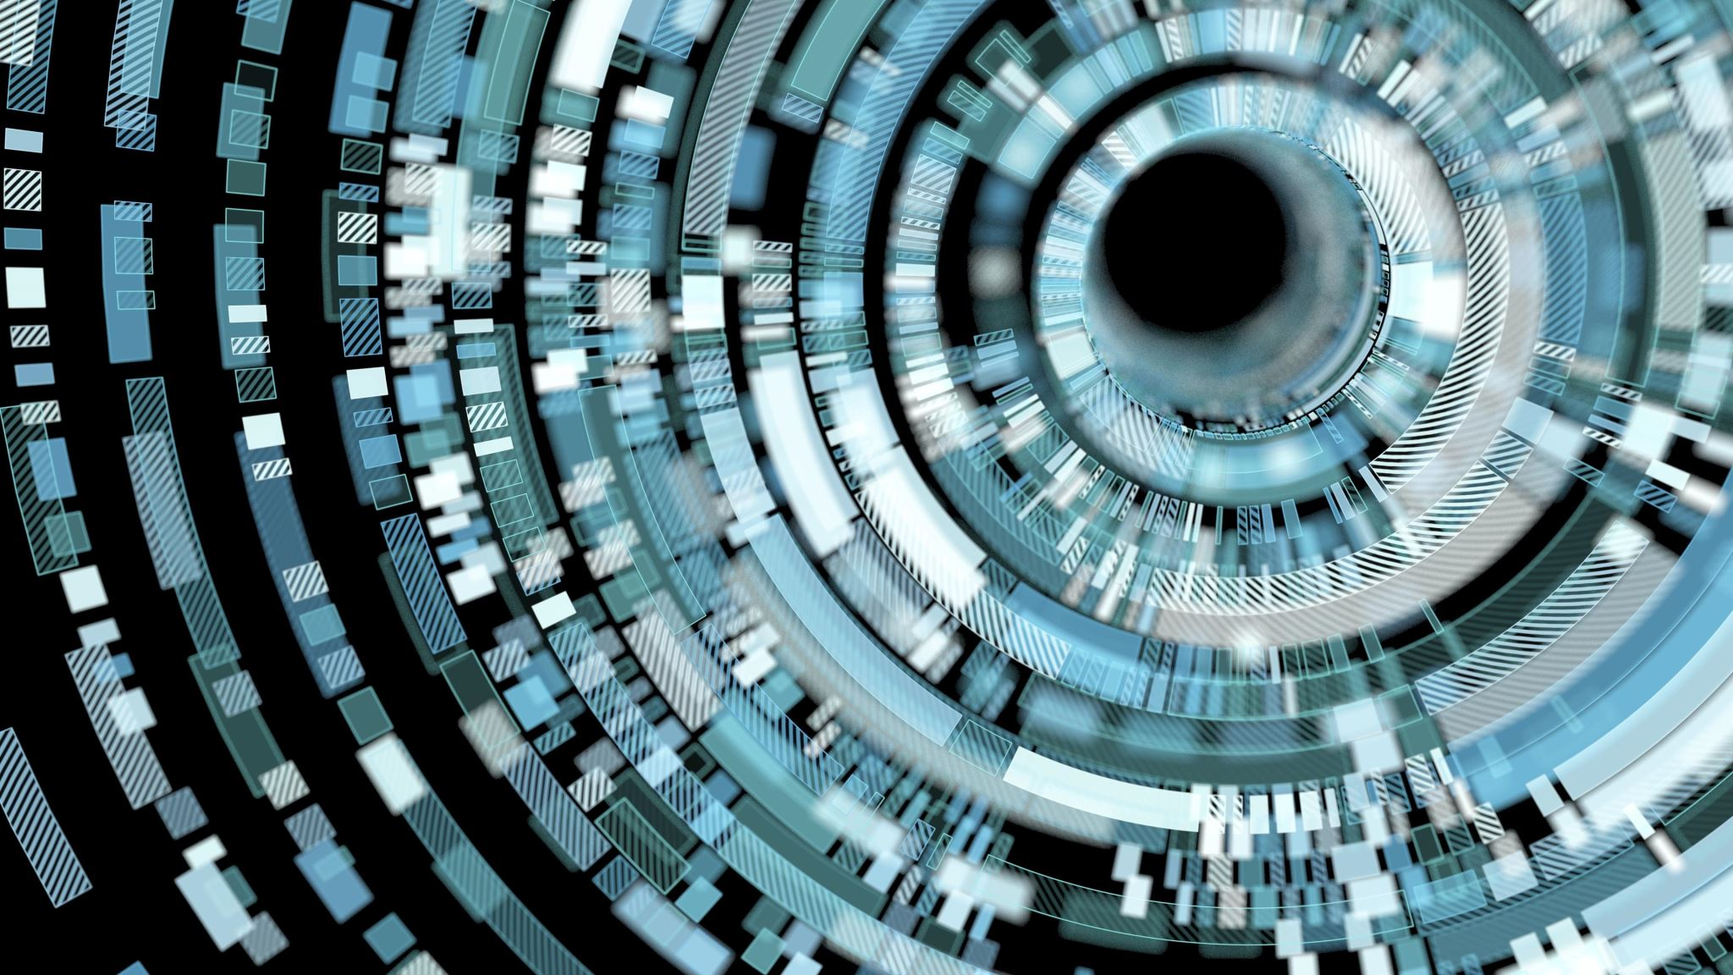
What is Optical Character Recognition (OCR)?
Optical Character Recognition (OCR) is a technology used to convert scanned or printed documents into editable text.
It allows for the extraction of text from images, making it easier to search, edit, and analyze textual information.

Slide 3


Tesseract Engine Overview
Tesseract Engine is an open-source OCR engine developed by Google.
It was initially developed by Hewlett-Packard Labs and later released as an open-source project in 2005.
Tesseract is widely used for its accuracy and versatility in recognizing text from various sources.

Slide 4

Tesseract Workflow
Tesseract OCR involves the following steps:
Image Preprocessing: This step includes noise removal, skew correction, and other enhancements to improve the image quality.
Text Segmentation: The image is divided into smaller segments, such as words or lines, to identify individual characters.
Character Recognition: Tesseract uses machine learning algorithms to recognize characters within the segmented regions.
Post-processing: The recognized text undergoes post-processing to refine the results, such as spell-checking and language modeling.

Slide 5

Tesseract Implementation
Installing Tesseract: Download and install Tesseract OCR engine on your computer.
Loading and Preprocessing the Image: Load the image containing the text and perform necessary preprocessing steps like resizing, denoising, and deskewing.
Configuring Tesseract Options: Set parameters for language, page layout analysis, and other OCR configurations.
Running OCR on the Image: Use Tesseract's API to apply OCR on the preprocessed image and extract the recognized text.

Slide 6

Tesseract Performance
Image Quality: Higher resolution and cleaner images yield better OCR results.
Text Font, Size, and Style: Clear and well-defined fonts are easier to recognize.
Language and Dictionary Support: Tesseract supports multiple languages and can benefit from language-specific dictionaries to enhance accuracy.

Slide 7
Tesseract Accuracy
Challenges and Limitations:
Tesseract may face difficulties in handling:
Handwriting Recognition: OCR accuracy decreases when dealing with handwritten text.
Complex Layouts and Formatting: Unconventional layouts or complex formatting can impact recognition accuracy.
Noisy or Distorted Images: Poor image quality with noise or distortions may lead to inaccurate results.

Slide 8
Applications of OCR
Digitizing Printed Documents: OCR enables the conversion of physical documents into editable digital formats, facilitating searchability and archiving.
Data Extraction from Invoices, Receipts, Forms, etc.: OCR automates data extraction, reducing manual effort and enabling efficient data processing.

Slide 9
Conclusion
Tesseract Engine provides a powerful and versatile solution for optical character recognition.
Its open-source nature and extensive features make it widely adopted in various applications.
OCR with Tesseract enhances productivity, improves data accessibility, and enables efficient information management.

Slide 10

THANK YOU

